Slide 1
HVAC (Heating, Ventilation and Air Conditioning)
IPRO 497-221
Hong Zhang

Slide 2
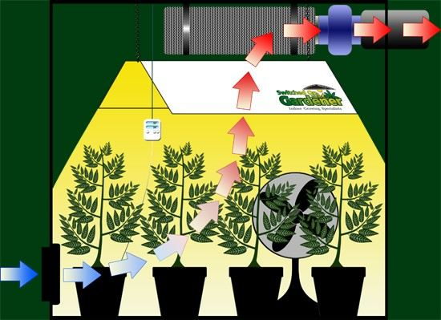
Hydroponic Ventilation
Ventilation is about controlling the quality of air, CO², heat and humidity.
Benefits of good air circulation and an exhaust system:
Protects plants against mold, bud rot and white powdery mildew
Less likely to get pests like fungus gnats and spider mites
Helps control heat & humidity to create a perfect growing environment
Strengthens stems by allowing them to bend & sway like in nature
Notes:
http://www.ecogrow.com/learning-center-grow-room-ventilation-c-283_299.html
http://plantozoid.com/how-to-set-up-grow-room-ventilation-system/

Slide 3
Heat
Plant tolerate temperatures range: 60°F – 92°F (17°C – 33°C)
Plant ideal temperature range: 70°F – 83°F (21.1°C – 28.3°C)
Human ideal temperature range: 70.7°F – 75.2°F (21.5℃ – 24℃)
Ideally,
When the lights are on: Try to stick around the 72°F to 77°F (22.2°C to 25°C) range for all growth.
Night: Reduce to 68°F.
Tips:
When other conditions are correct, the rate of photosynthesis doubles for each 10^{O}C (18^{O}F) rise in temperature. This principle applies within the 10-30^{O}C (50-86^{O}F) range for temperate plants and 15-35^{O}C (59-95^{O}F) for tropical plants.
Notes:
http://howtogrowmarijuana.com/hydroponic-ventilation-fans-cooling-co2/
http://flairform.com/hints/temperature_air.htm

Slide 4
Humidity
Plant Ideal relative humidity levels are:
80 – 90% during cloning stage
60 – 70% during vegetative growth
40 – 60% during flowering.
Human Ideal Plant relative humidity levels: 35 – 65%
You should aim for 50-75% humidity in the workplace when your lights are on.
In summer, use a humidifier to add additional moisture.
During the winter months, use an extractor fan to replace fresh CO² rich air and for dehumidification (removing moisture), rather than reducing temperature.
Notes:
http://www.growersguidetocannabis.com/ventilation-getting-good-air-flow-for-your-cannabis-grow/
http://www.ecogrow.com/learning-center-grow-room-ventilation-c-283_299.html

Slide 5
CO²
Good ventilation greatly aids CO², which is vital for photosynthesis.
Fresh air has on average 390 PPM (parts per million) of CO².
An intake fan will bring fresh CO² rich air into your grow room.
A tank of CO² can supply indoor insufficient CO².
Activity | Respiration per Person | Carbon Dioxide Emission per Person
 | (m³/h) | (m³/h)
Sleep | 0.3 | 0.013
Resting or low activity work | 0.5 | 0.02
Normal work | 2~3 | 0.08 - 0.13
Hard work | 7~8 | 0.33 - 0.38
Notes:
http://www.growersguidetocannabis.com/ventilation-getting-good-air-flow-for-your-cannabis-grow/
http://www.ecogrow.com/learning-center-grow-room-ventilation-c-283_299.html

Slide 6
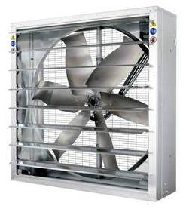
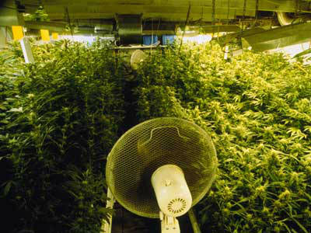
Hydroponic Ventilation
Using an extraction fan high up in the room to facilitate air flow and prevent stratification
Extraction Fan: more than $ 200
Using an oscillating fan within the grow room will help with air circulation.
Oscillating Fan: $100 ~ $800
Notes:
http://howtogrowmarijuana.com/hydroponic-ventilation-fans-cooling-co2/

Slide 7
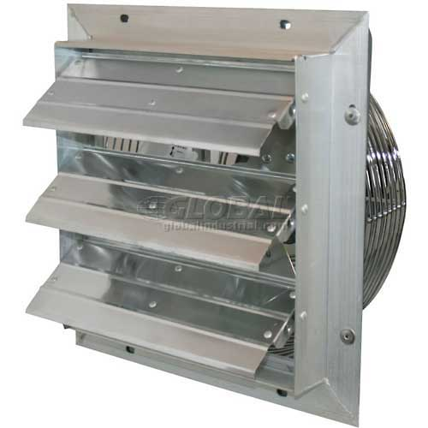
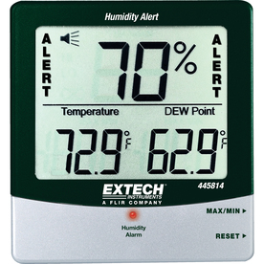
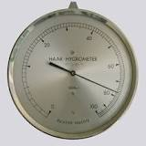
Hydroponic Ventilation
Used for pushing air into the room and helps to maximize the effectiveness and lifespan of the exhaust fan.
Inlet fan: $100 ~ $800
Position the probe in the place of highest temperature or humidity. This is typically directly beneath the lights and amongst the foliage.
Thermometers and hygrometers:
$100
Notes:
http://howtogrowmarijuana.com/hydroponic-ventilation-fans-cooling-co2/

Slide 8
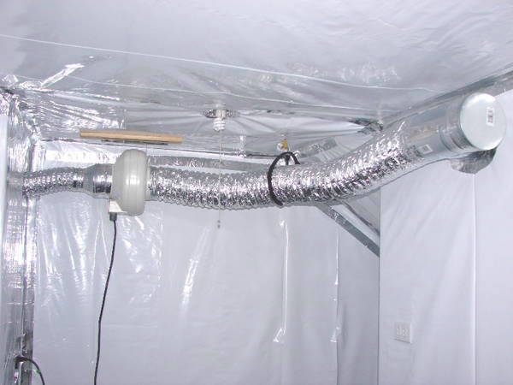
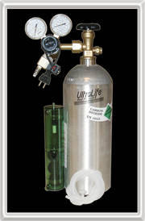
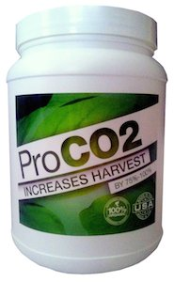
Hydroponic Ventilation
Ducting can move air a distance to an exterior vent.
Ducting: $ 200 ~ $1,000
CO² Tank: $20 ~ $ 200
CO² Bucket: $60 ~ $140
Notes:
http://howtogrowmarijuana.com/hydroponic-ventilation-fans-cooling-co2/

Slide 9
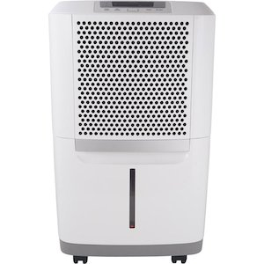
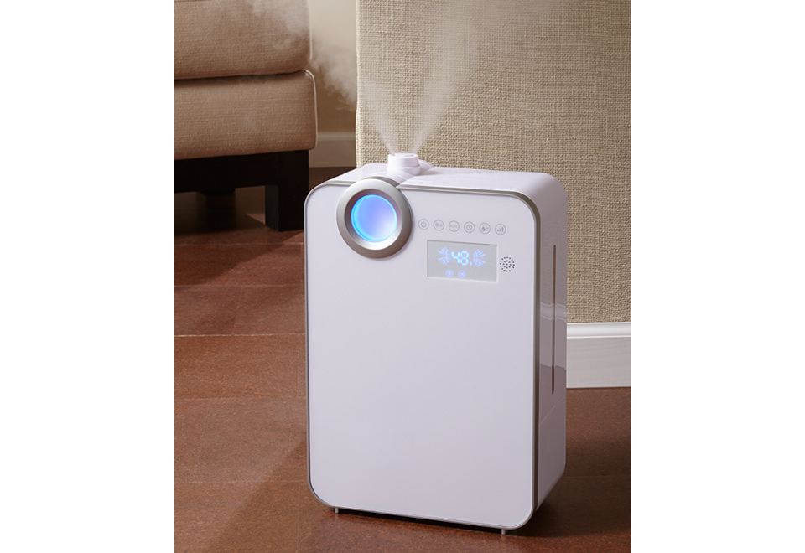
Hydroponic Ventilation
Dehumidifier: $240 ~ $4,000
Humidifier: $100 ~ $500

Slide 10
How to size your exhaust fan
Step 1 – Room Volume
growing area = length x width x height
Step 2 – CFM Required
CFM required = growing area / exchange minutes
For example, the fan exchange the air in a grow room once every three minutes. Therefore, 512 cubic feet/3 minutes = 171 cfm.
Tip: As a general rule, maximum winter ventilation rates rarely exceed 12-20 air changes per hour; however, maximum summer air exchange rates can go up to 60 air changes per hour.
Step 3 – Additional factors
1. Number of HID lights – add 5% per air cooled light or 10-15% per non-air cooled light.
2. CO2 – add 5% for rooms with CO2 enrichment
3. Filters – if a carbon filter is to be used with the exhaust system then add 20%
4. Ambient temperature – for hot climates (such as Southern California) add 25%, for hot and humid climates (such as Florida) add up to 40%.
Notes:
http://sdhydroponics.com/resources/articles/gardening/ventilation-basics-explained

Slide 11
How to size your exhaust fan
Example:
In our 8’ x 8’ room we have 2 x 1000w air cooled lights, and we plan to use a carbon filter. We also plan to use CO2 in this room. The ambient temperature is 90°F, however, we will be using air from another room that is air-conditioned.
Minimum Required CFM to ventilate room:
(CFM required for room – step 2) + (CFM required for room – step 2 x 10% (2 air cooled lights)) + (CFM required for room – step 2 x 5% (CO2)) + (CFM required for room – step 2 x 20% (Carbon Filter)) + (Ambient Temperature 0 (Air coming from air-conditioned room)).
= (171cfm) + (171cfm x 10%) +
(171cfm x 5%) + (171cfm x 20%) + ( 0 )
= 231cfm – this is the absolute minimum cfm required to ventilate your room.
Notes:
http://sdhydroponics.com/resources/articles/gardening/ventilation-basics-explained

Slide 12
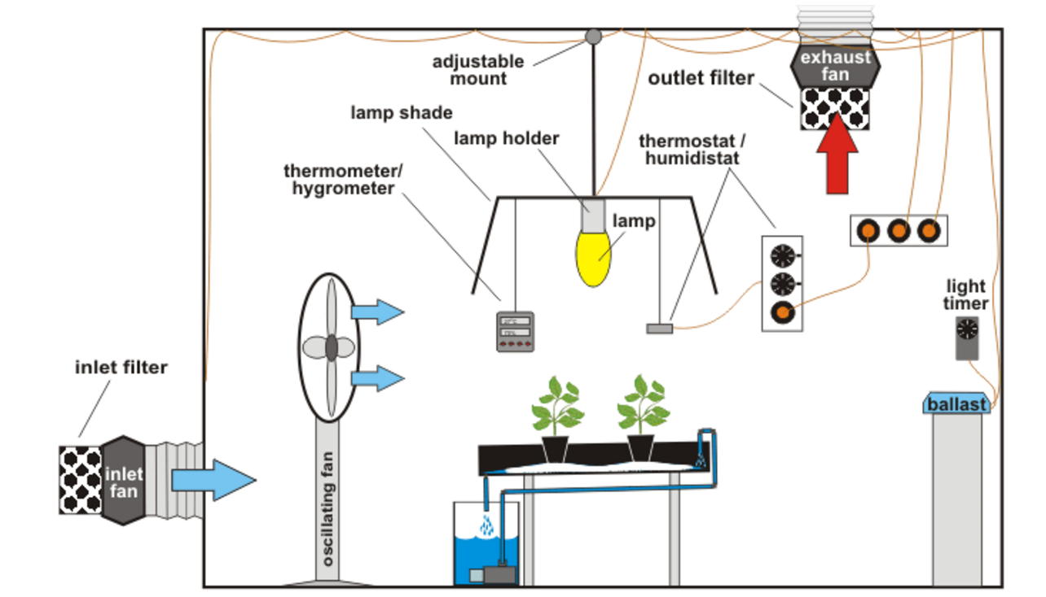
Layout
Basic equipment for ventilation & lighting (side view)
Notes:
http://www.flairform.com/hints/ventilation_2.htm

Slide 13
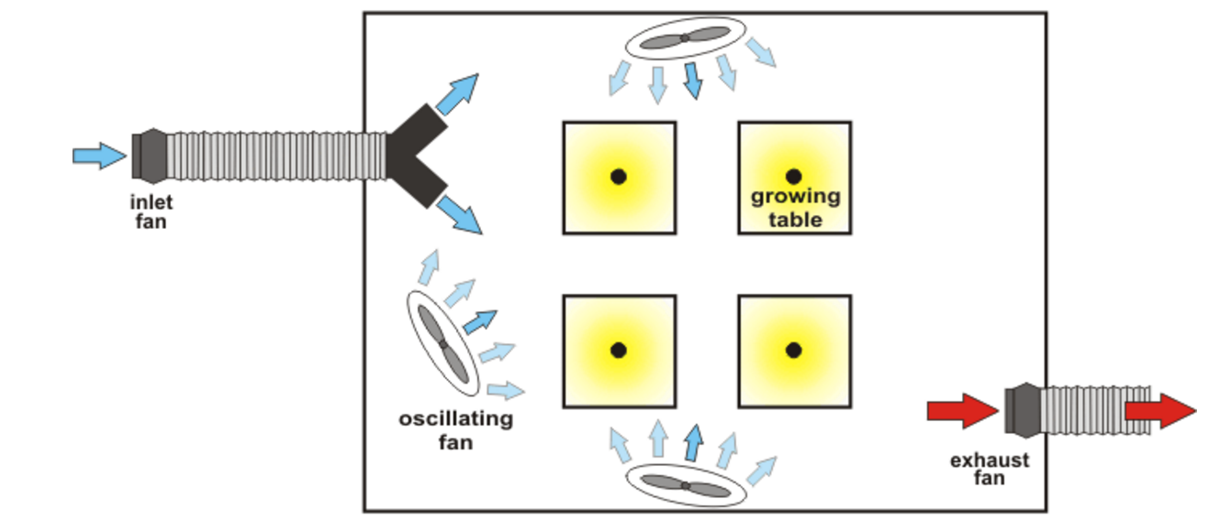
Layout
Basic equipment for ventilation & lighting (aerial view)
Notes:
http://www.flairform.com/hints/ventilation_2.htm

Slide 14
Layout Rule
Dimensions
- Allocate sufficient clearance around the plants for maintenance.
- Position plants at a convenient working height.
- It is beneficial to have a minimum gap of 1 meter (3 ft) between the lamp shade and the ceiling. Location of inlet, exhaust and oscillating fans
Keep the air moving in one direction as this creates and maintains air momentum.
Locate the ‘inlet’ and ‘exhaust’ at opposite ends of the room, with an oscillating fan maintaining the general airflow direction provided by the inlet. For wider rooms especially, employ multiple inlets and exhausts, and space them evenly across the width of the room.
For best airflow, keep objects at least 1 meter (3 ft) away from the fan inlet.
Notes:
http://www.flairform.com/hints/ventilation_2.htm

Slide 15
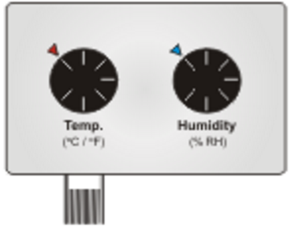
Controlling and optimizing ventilation systems
Switching fans on & off
“Automated” fan switch: Thermostats and humidistats are useful for activating both the inlet and the exhaust fan. Position the thermostat’s sensor at the hottest point in the foliage, and the humidistat’s sensor at the most humid point. Determine these points using a thermometer and hygrometer.
“Day time” (lights-on): >27ºC (80ºF) >70% RH.
“Night time”: 15ºC ~ 20ºC (59ºF ~ 68ºF)
An ‘axial’ fan in the ceiling
(controlled with or without a timer)
may be sufficient to produce the
correct night time conditions.
Notes:
http://www.flairform.com/hints/ventilation_3.htm

Slide 16
Controlling and optimizing ventilation systems
Ventilation for extreme climates
Hot climates
1. Air-condition the incoming air.
2. Reduce the amount of lighting.
3. Use insulation in the surrounding rooms so they do not amplify the temperature of the grow room.
Cold climates
If the temperature is too low, consider pre-heating the incoming air.
A fan speed controller is a useful addition where the fan's flow rate is too high during the colder or less humid months.
Notes:
http://www.flairform.com/hints/ventilation_3.htm

